Slide 1


Slide 2

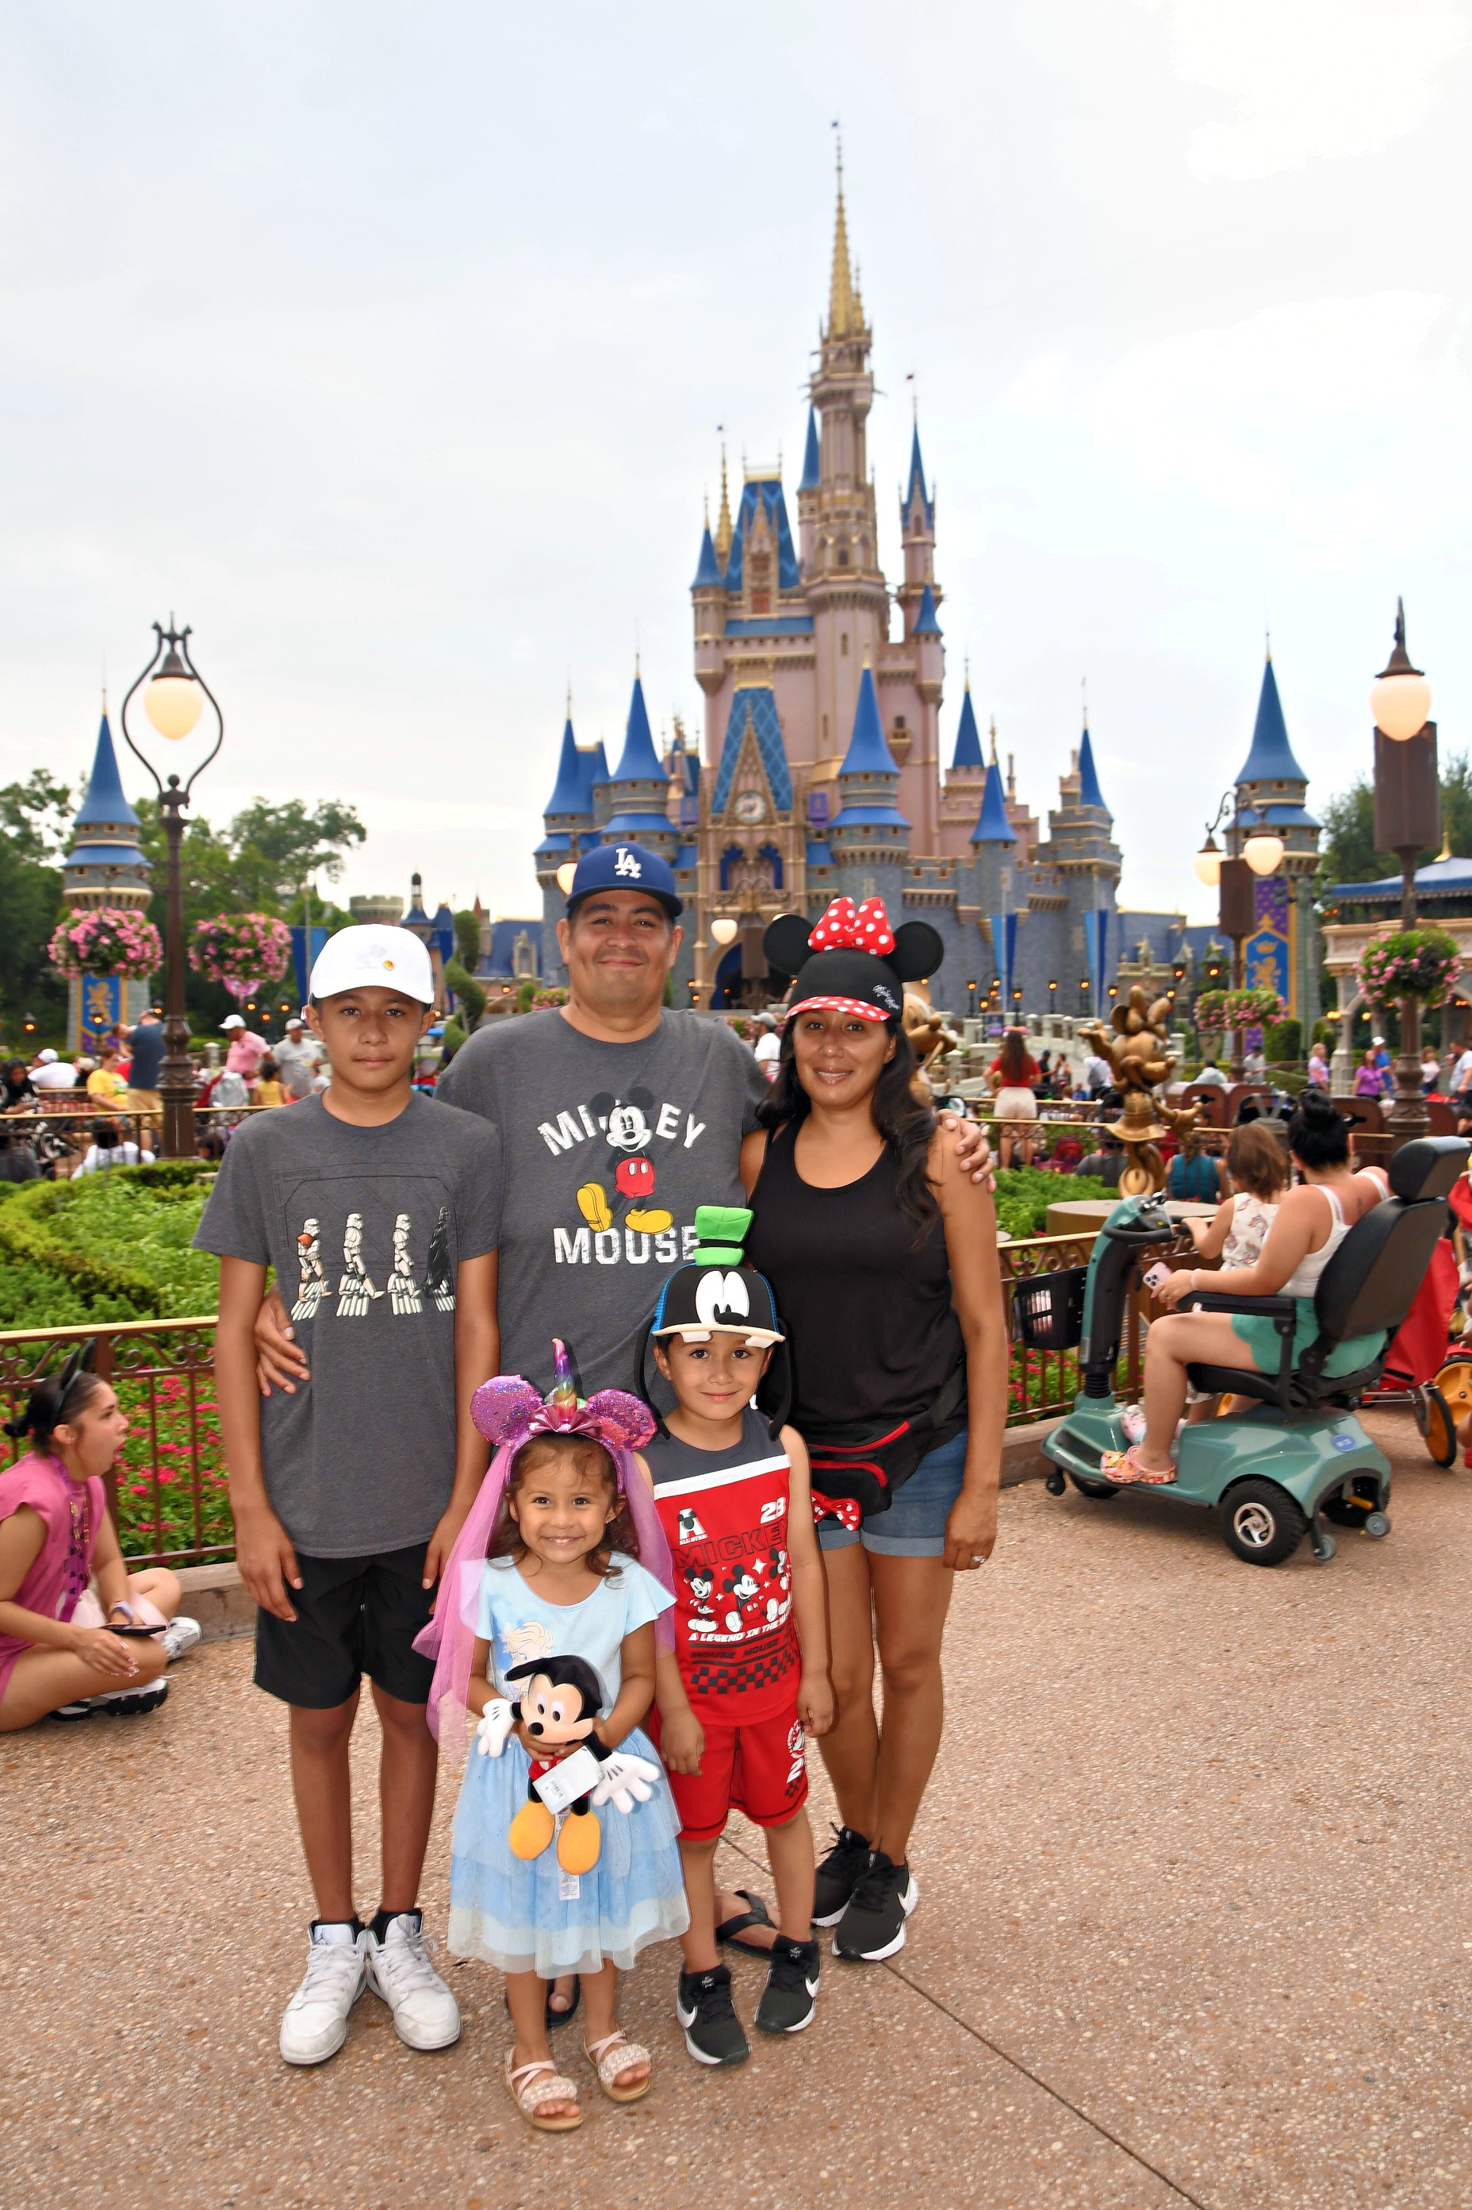
•Mrs. Pedroza
•11th year teaching Kindergarten.
•Bachelors Degree from Cal Poly Pomona in Liberal Studies.
•Masters Degree in Education with an emphasis in Reading from the University of La Verne.
•Microsoft Lead Teacher

Slide 3

Email: Claudia_Pedroza@chino.k12.ca.us
Phone: (909) 947-9749
  Ext:6701
Bloomz: Phone app (best way to contact me)
Text Code: @GPB8M7 TO 59674
*24-48 hour response time

Slide 4

Circle Time
Language Arts
Phonics
Writing
Reading
Sight Words
Nutrition
Story Time
Math
Science

Slide 5

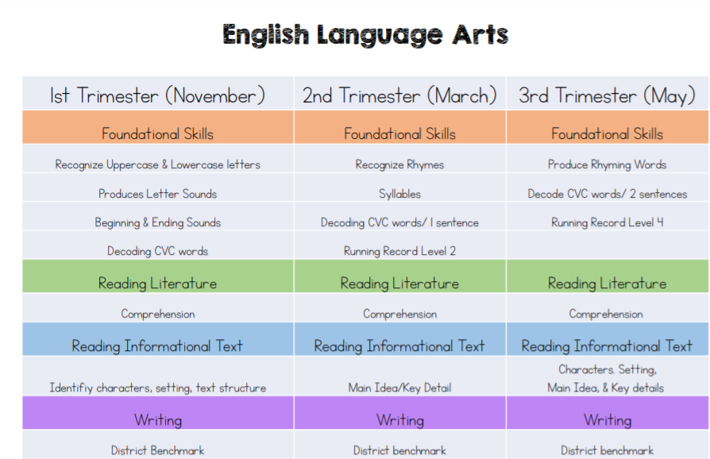

Slide 6
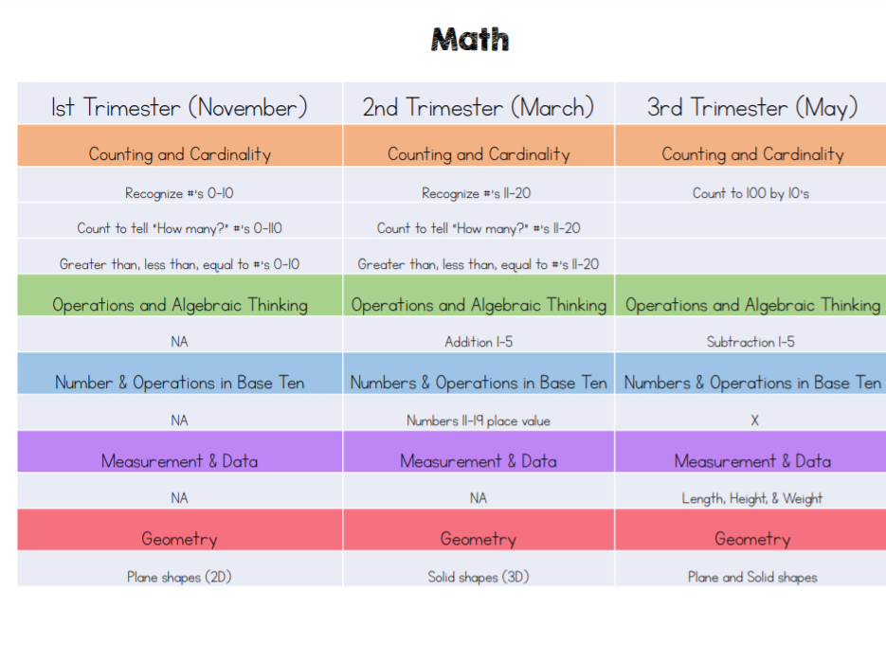

Slide 7
Six Sets of Sight Words
Orange – Yard Sign 10/6/2024
Yellow – Big Kids Playground 11/15/2025
Green - Pizza Party 1/10/2025
Blue – Outdoor Activity 2/28/25
Purple – Dance Party 3/21/25
Pink – Medal 5/16/2025

Slide 8
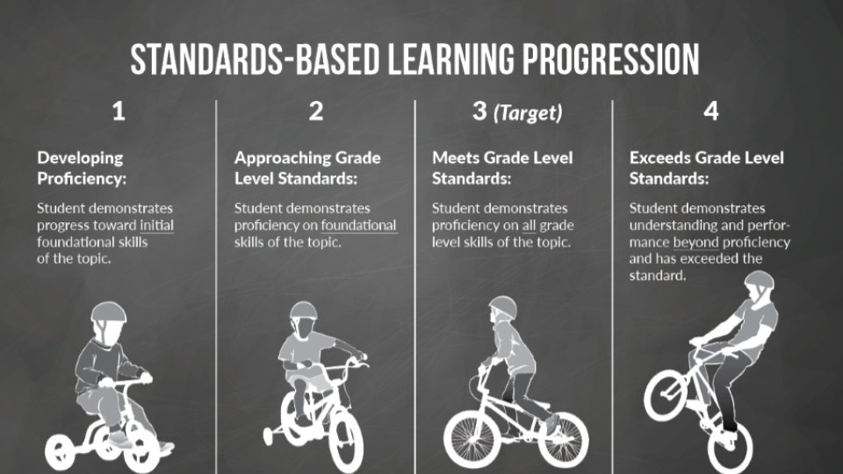
Grading
ESGI Testing
District Exams
Homework
Report Card Grading Scale
4 excelling
3 Achieving
2 progressing
1 beginning/not met

Slide 9

Homework
Homework will begin this Friday.
Folders will go home every Friday.
Students will return them to school on Friday.
Homework will consist of:
At home Family Projects
Nightly Reading
Assigned Math pages from their Black Math Book
Practice Letters, Sounds, Numbers and Sight Words.

Slide 10
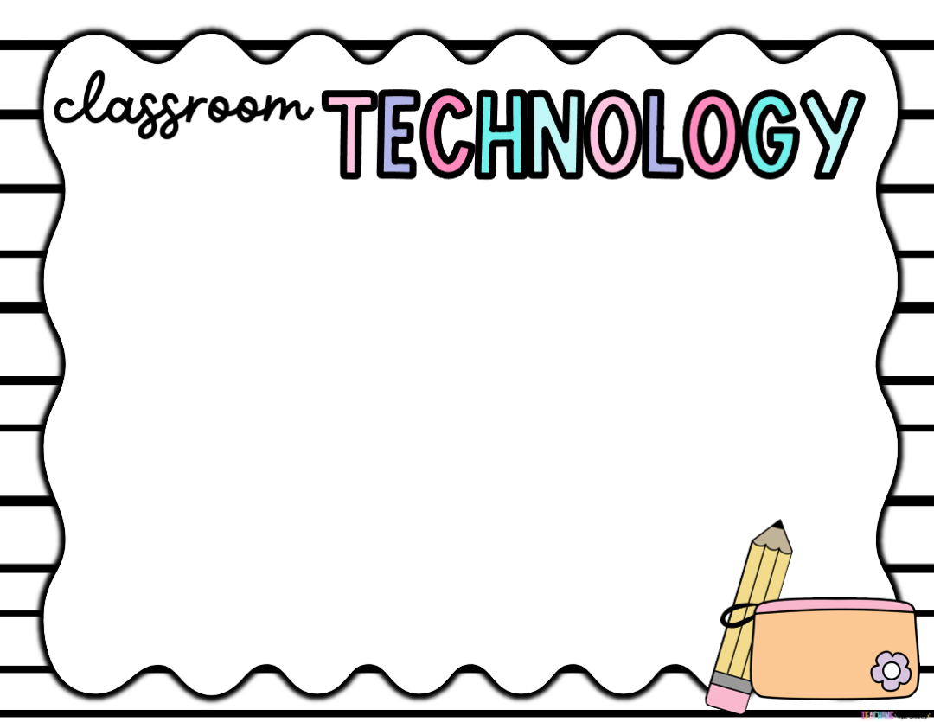
Every Student is assigned a Chromebook and headphones in the classroom.
Teams Assignments
Device Protection Plan can be purchased online.
$40

Slide 11
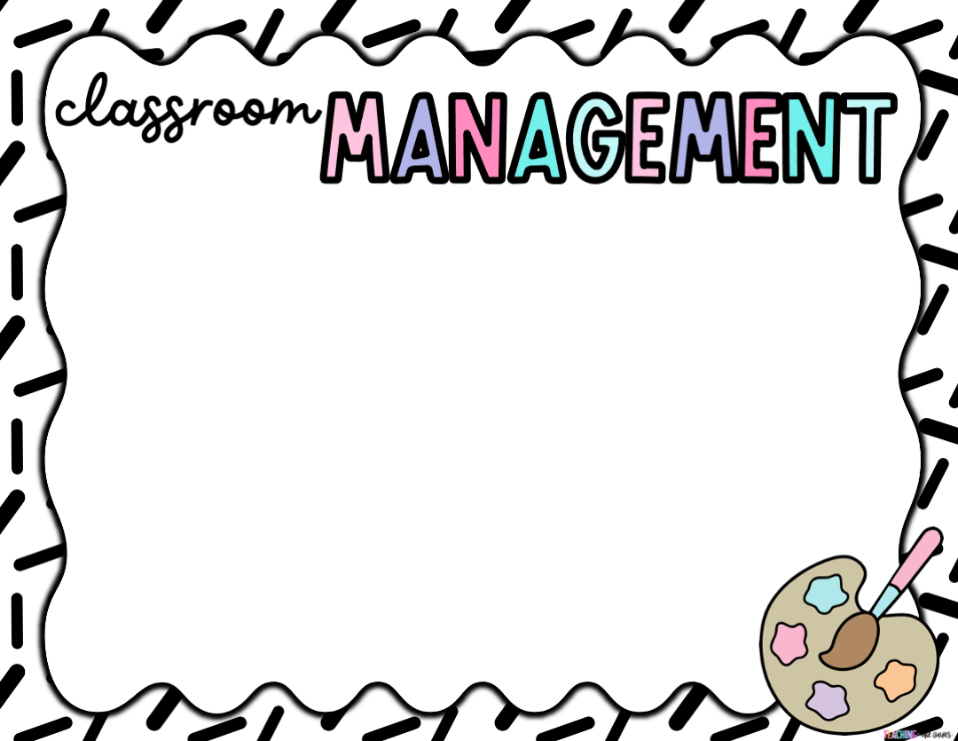
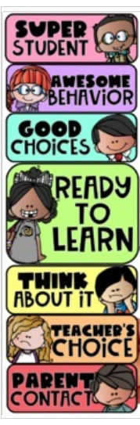
PBIS Gold School
Patriot Bucks
Clip Chart
Intervention Logs
Office Referrals
Be Responsible Be Respectful
Be Safe

Slide 12

We celebrate birthdays the last 10 minutes of class.
Goodie Bags
Mini Cupcakes
Prepackaged Treats
Unbirthdays in the month of May

Slide 13

Healthy Snacks
Water
No candy or sugary drinks
Breakfast 7:20 am-740 am
Lunch 11:15 am - 11:50 am

Slide 14

Room Parent (coordinate classroom parties, volunteers in the classroom)
Volunteers for Centers on Wednesdays and Fridays from 8:00 am- 9:30 am
Prep crafts

Slide 15

September 16th – 20th
^{Middle of our first trimester}
^{Discuss:}
^{Academics}
^{Behavior}
^{Reading Program}
^{Sign up through Bloomz}

Slide 16

Be Respectful Be Responsible Be Safe
Personal Space
Hands to our own body
Being a Kind Friend
Using our voice to solve problems not our hands
Communication Protocol
-Inform the teacher
-Principal
-Keep our classroom healthy

Slide 17

PTO Membership Drive
-8 more memberships to reach 100% and WIN!!!
Tie-Dye on August 28, 2024
-Please send in a white shirt
Water Day 9/6/2025

Slide 18

Monday- Tie-Dye
Friday- Patriotic Wear

Slide 19



Slide 20


Slide 21


Slide 22


Slide 23


Slide 24
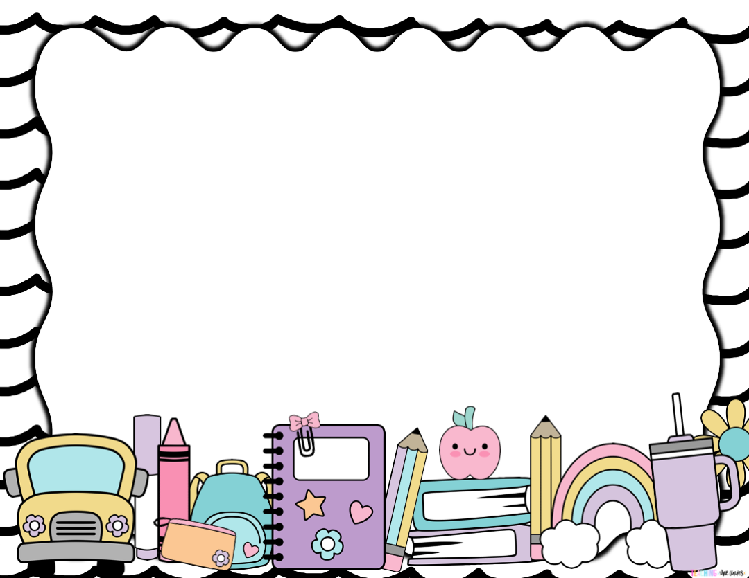

Slide 25


Slide 26


